Slide 1




DEPI Graduation Project Presentation
Digital Egypt Pioneers Initiative (DEPI)
Track : Software Testing Track
Project Name : ParaBank Testing Project
Prepared by :
Ghada Muhammed Hussien

Slide 2
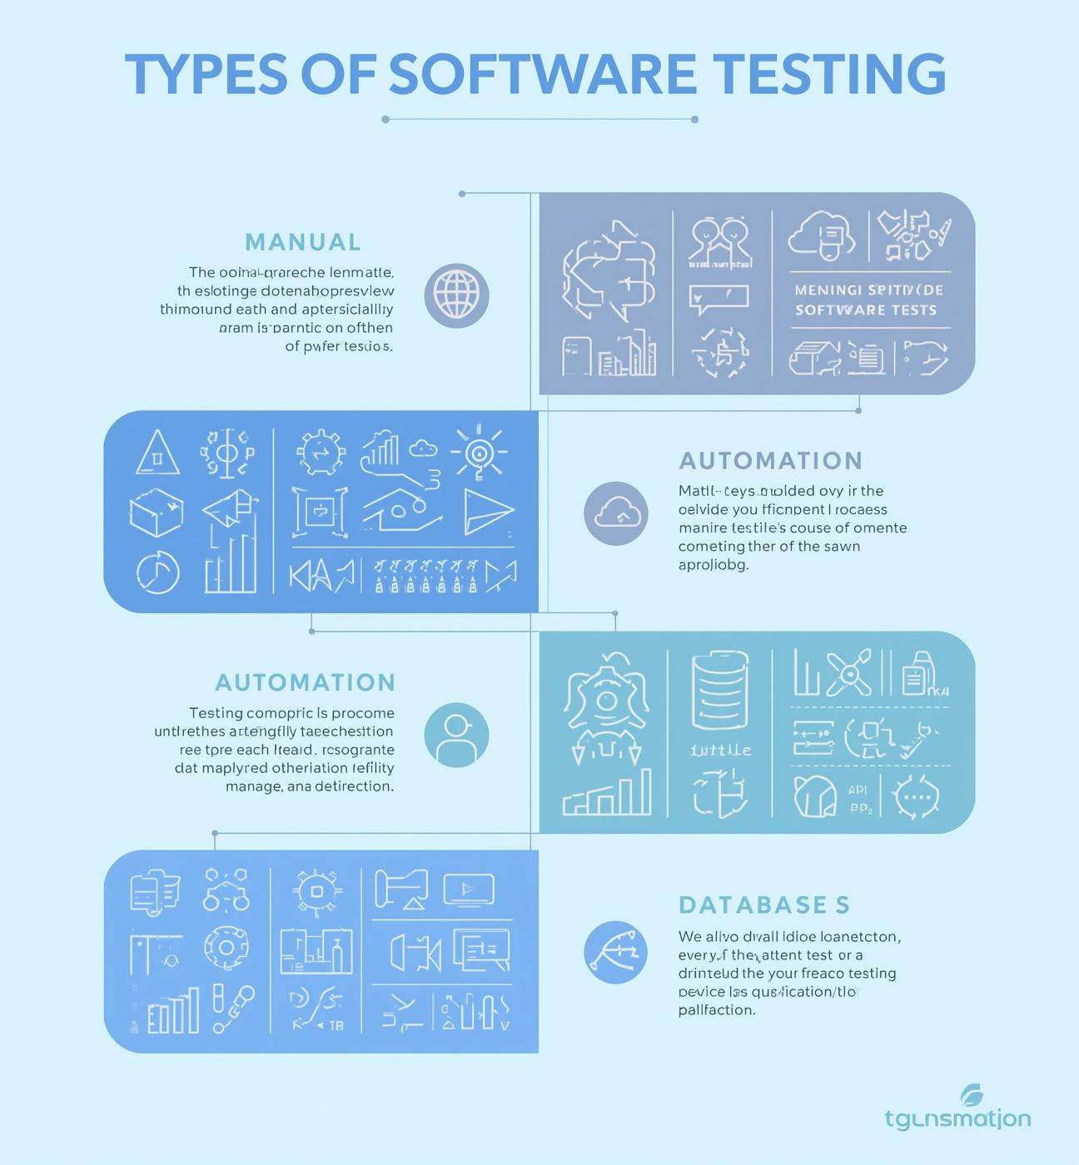
Project Overview:
  ParaBank is an online banking web application developed by Parasoft that simulates real-world banking operations such as account registration, login, fund transfer, bill payment, and transaction management.
  Our graduation project focuses on testing and validating this system through a comprehensive manual and automated testing framework.
  The aim is to ensure that all functionalities work correctly, efficiently, and securely under different conditions.
  The project follows the Agile Scrum methodology, applying multiple testing phases across four sprints — from planning to execution and reporting.
  We utilized industry-standard tools such as Selenium, Postman, Jira, and Jenkins to automate workflows, manage defects, and generate professional test reports.

Slide 3

Overview:
User-friendly interface for testers
Comprehensive testing coverage and reporting
Supports various testing methodologies
A modern and intuitive testing interface designed to simplify workflows for QA teams. It enables testers to execute, monitor, and validate complex banking scenarios easily, while maintaining clarity, consistency, and high usability standards across the system.
The framework provides end-to-end coverage of functional, regression, API, and database testing. All executions are tracked in Jira and reported via Jenkins dashboards, ensuring full transparency, real-time defect analysis, and measurable quality metrics.
Combines Manual, Automated, and Continuous Integration (CI/CD) approaches using Selenium, TestNG, and Postman to maintain efficiency, scalability, and high confidence in software reliability under all operating conditions.

Slide 4
Testing Phases Timeline
Planning
Design
Execution
Reporting
Defined the overall testing objectives, scope, and strategy for the ParaBank web application.
Prepared the official Test Plan, selected testing tools (Selenium, Jira, Postman), and set up the environment. This Phase established the foundation for all upcoming testing activities.
Created and reviewed detailed manual and automated test cases covering UI, API, and Database layers. Designed the automation framework using Page Object Model (POM) to ensure scalability and easy maintenance. Delivered a complete, reviewed test suite ready for execution.
Executed test cases manually and through automation scripts using Selenium and TestNG. Tracked defects in Jira, performed regression testing, and integrated tools like Jenkins for continuous testing. Validated stability and functionality across all major modules.
Generated detailed Test Summary Reports and analyzed defect trends and KPIs. Summarized results through Jenkins dashboards, ensuring transparency and quality insight.
Closed the testing cycle with validated, stable, and fully documented outcomes. Defined the overall testing objectives, scope, and strategy for the ParaBank web application.

Slide 5
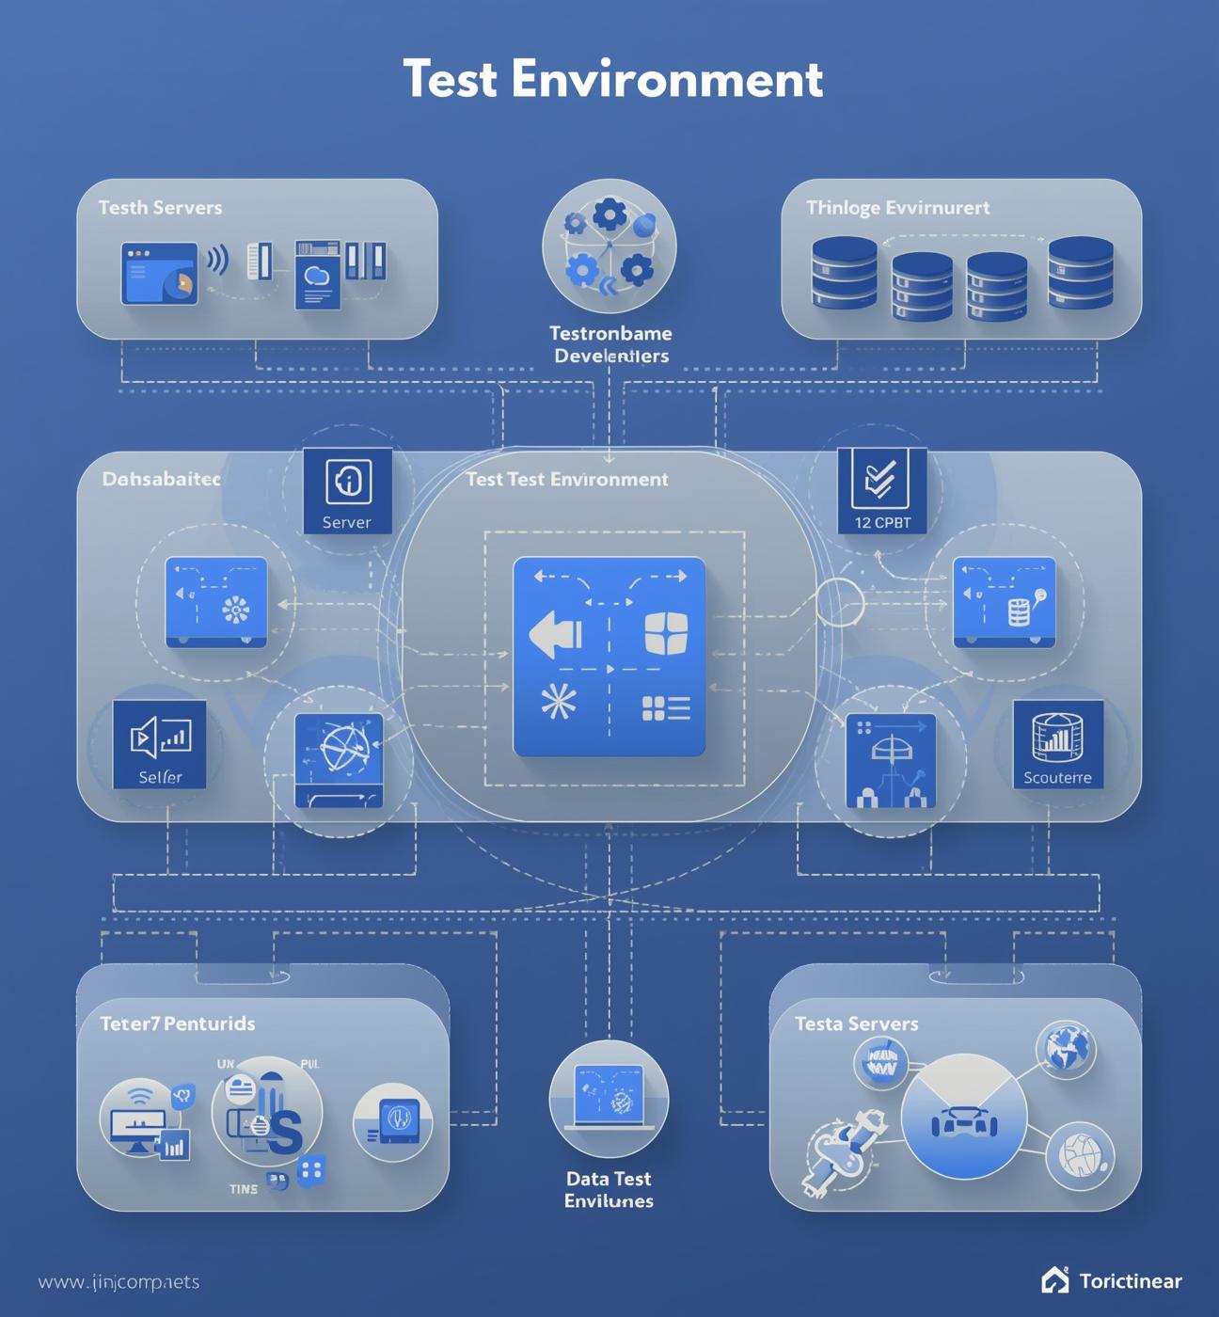
Test Plan
  Scope: Covers functional and non-functional testing across UI, API, and Database layers of the ParaBank system, ensuring both front-end and back-end validation..
  Objectives: Guarantee application stability and reliability through manual and automated testing. And validate critical workflows, optimize regression coverage, and provide quality insights via Jenkins and Jira dashboards.
  Entry Criteria: All test cases are designed, the environment is configured, and test data is ready. Automation scripts integrated with Selenium, TestNG/Cucumber, and Postman API tests are prepared.
  Exit Criteria: All high and critical defects resolved, all regression cycles passed, and coverage goals achieved with stable automation execution.
  Test Environment: A cloud-based and fully integrated setup combining: Selenium + TestNG/Cucumber for automation execution, Postman for API validation, Jira for defect tracking and test management, and Jenkins for CI/CD integration and continuous reporting.

Slide 6
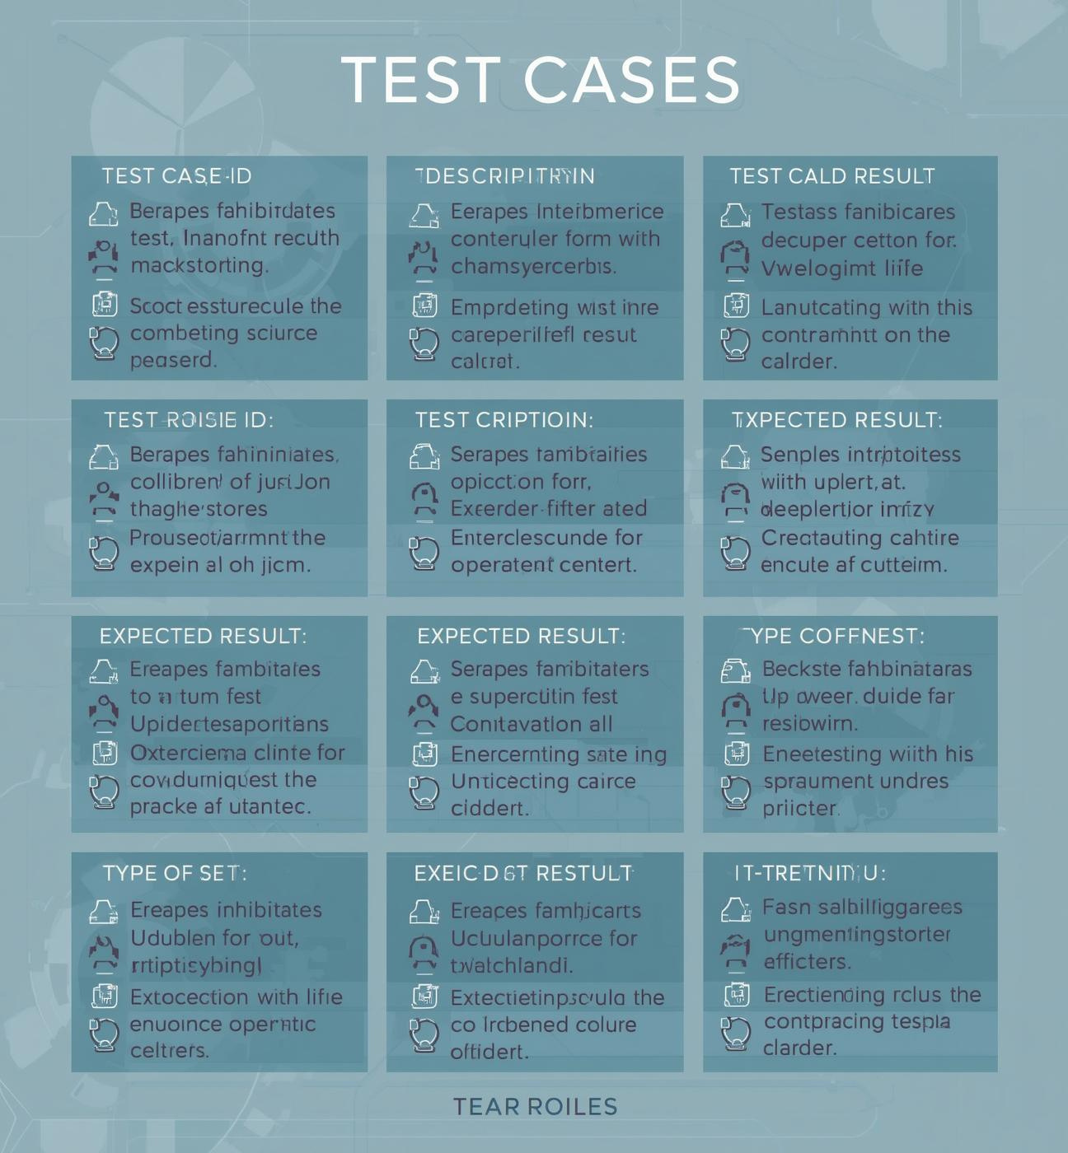
Test Design
  Designed manual, automated, API, and database test cases to validate all functional and regression scenarios in the ParaBank application.
  Defined clear inputs, execution steps, expected results, and postconditions for each test case.
  Applied advanced techniques such as Equivalence Partitioning, Boundary Value Analysis, and Data-Driven Testing to ensure accuracy and coverage.
  Developed automation scripts using Selenium and TestNG for UI and functional testing.
  Designed SQL queries for database verification to ensure correct data storage, retrieval, and integrity after each transaction.

Slide 7
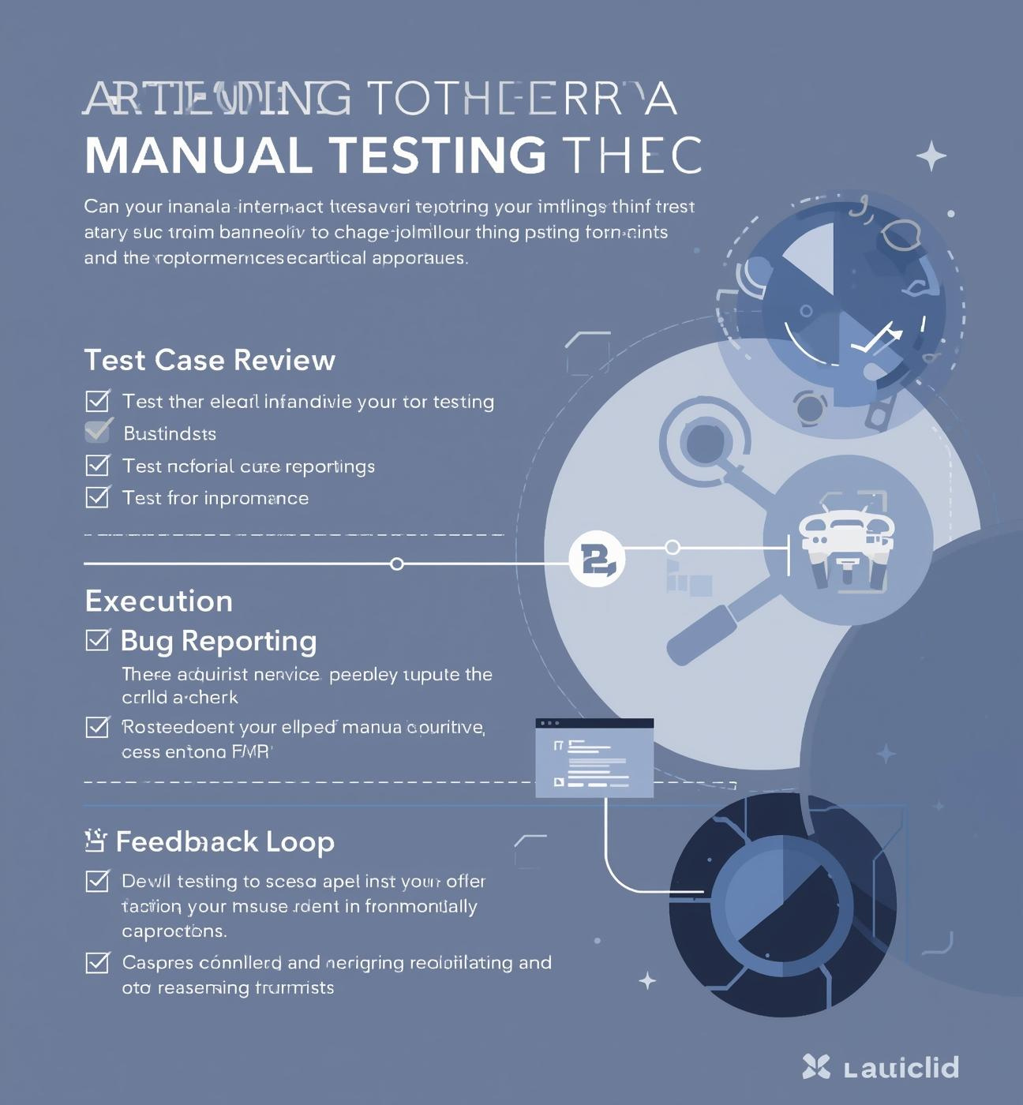
Manual Testing - Prepared by Ghada Muhammed Hussien
  Performed manual functional and exploratory testing on key ParaBank features, including login, registration, fund transfer, and bill payment.
  Executed multiple test cases, detected various bugs and defects, and documented them in Jira for tracking and resolution.
  Prepared a detailed Bug Summary Report, highlighting defect categories, priorities, and root causes to support continuous improvement.
  This phase ensured system functionality, usability, and stability before proceeding with automation testing.

Slide 8

Automation - Prepared by Muhammed Mahmoud Khamis & Ahmed Ramadan Ali
  Developed automation scripts to validate the core functionalities of the ParaBank web application,
  including login, registration, fund transfer, and account summary operations.
  Used Selenium WebDriver with TestNG to automate repetitive and regression test cases, reducing manual effort and execution time.
  Integrated automation scripts with Jenkins CI/CD, enabling continuous execution and automatic reporting.
  This phase ensured faster testing cycles, consistent results, and improved overall system reliability.

Slide 9

API Testing - Prepared by Mustafa Abdulrahman Hamed
  Performed API validation and integration testing for the ParaBank application using Postman.
  Tested all RESTful endpoints to verify response codes, data accuracy, and request integrity between client and server.
  Executed multiple CRUD operations (Create, Read, Update, Delete) to ensure correct data flow through backend services.
  This phase ensured strong communication between system layers and reliable backend performance.

Slide 10
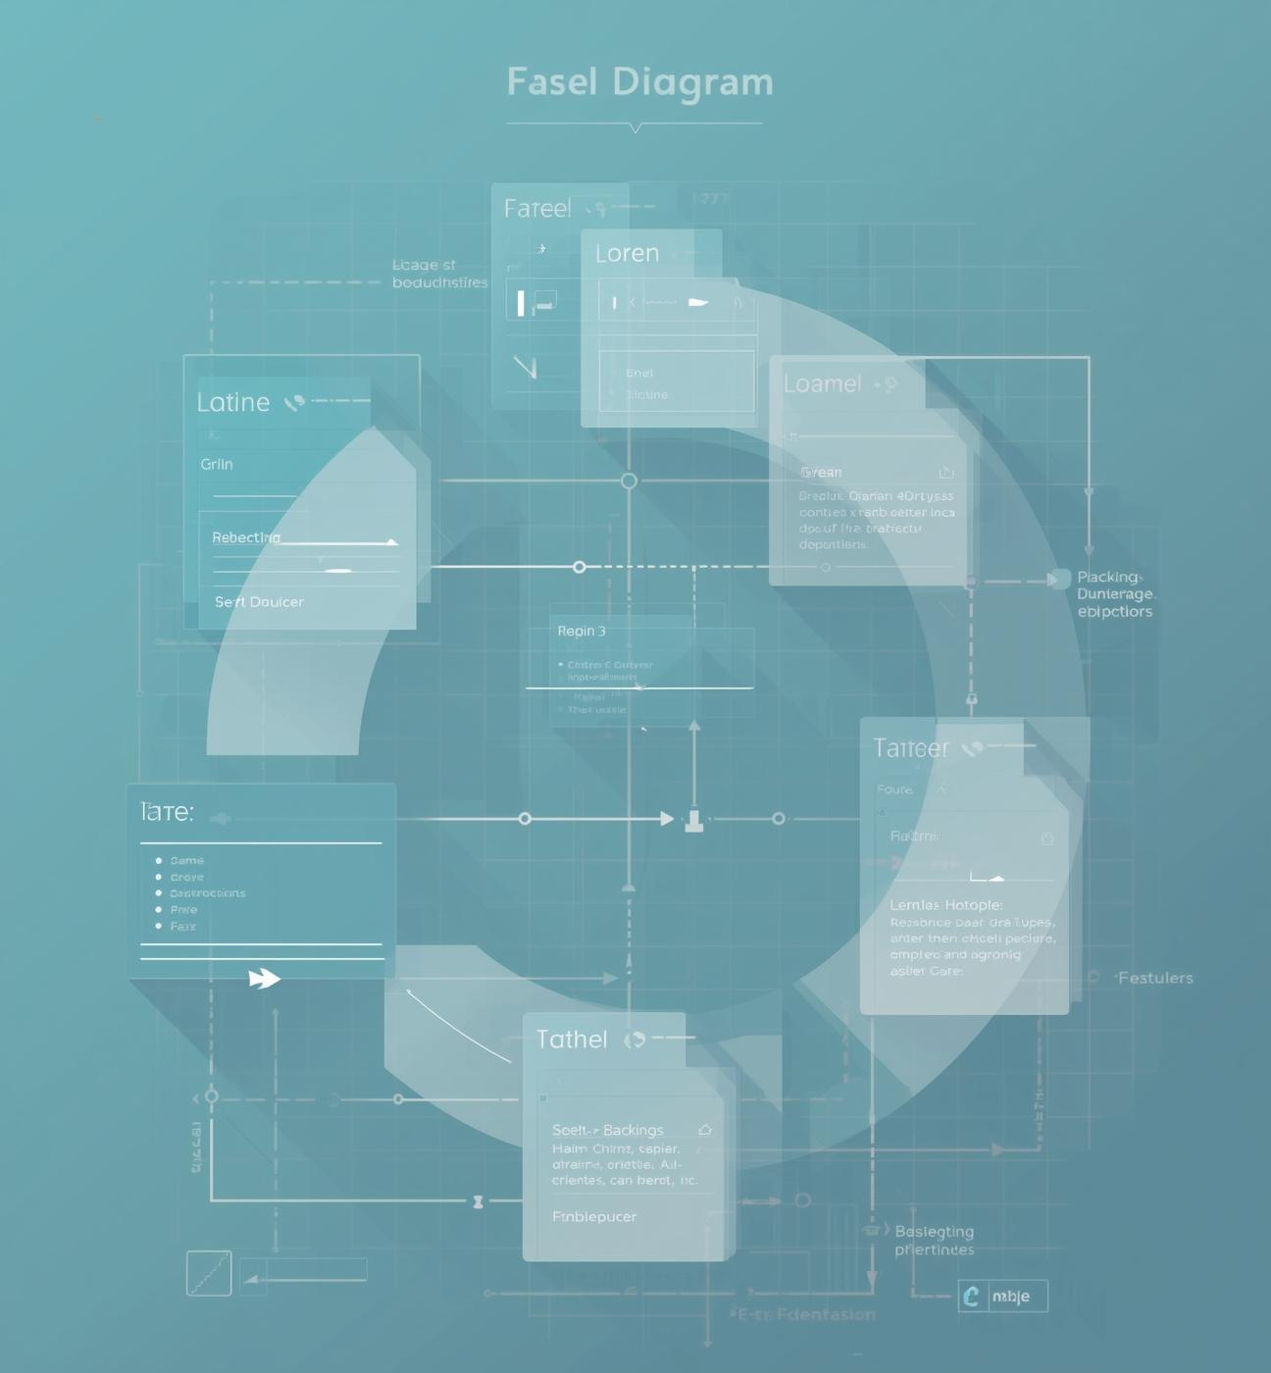
Database Testing - Prepared by Manar Ashraf Ali & Dina Mohamed Merza
  Performed backend data validation and integrity testing for the ParaBank system to ensure accuracy after each transaction.
  Executed multiple SQL queries to verify data insertion, updates, and deletion operations across customer and transaction tables.
  Validated that front-end operations (such as fund transfer and bill payment) correctly reflected in the database records.
  Checked constraints, relationships, and triggers to maintain data consistency and reliability.
  This phase ensured that all banking operations were properly stored, processed, and retrieved without data loss or corruption.

Slide 11


Test Execution
Total
Outcomes
87%
Impact
217 test cases executed
188 Passed , 29 Failed
Success rate of tests
Strengthened system stability and improved user experience

Slide 12
Challenges
Technical
Process
Testing
Tools
Minor challenges in test environment setup and integration between tools like Jenkins, Jira, and Postman.
Quickly resolved through team collaboration and tool reconfiguration.
Occasional need for cross-team coordination to align manual, automation, and API testing tasks.
Managed effectively using Agile stand-ups and sprint retrospectives.
Faced a few flaky test cases during automation runs due to network and timing delays.
Stabilized scripts by adjusting waits and improving environment consistency.
Minor adaptation required for defect tracking and reporting in Jira.
Enhanced templates and workflows to streamline bug documentation.

Slide 13
Project Conclusion & Final Reflections
Summary, Improvements, and Team Appreciation
Key Achievements
Suggested Improvements
Team Acknowledgment
Our team successfully designed and implemented a complete manual and automated testing framework for the ParaBank web application.
We ensured high-quality software performance through comprehensive UI, API, and Database testing, detecting and resolving defects efficiently.
The project enhanced our practical skills in using Selenium, Postman, Jenkins, and Jira, following the Agile Scrum methodology.
For future iterations, expanding the automation coverage to include performance and security testing is recommended.
Integrating advanced reporting tools and improving test data management can further optimize testing efficiency.
Additionally, continuous enhancement of CI/CD pipelines will ensure faster feedback and better scalability.
We would like to express our sincere gratitude to our Digital Egypt Pioneers Initiative (DEPI) supervisors and mentors
for their continuous guidance and support.
Special thanks to all team members for their collaboration, commitment, and effort throughout this project journey.

